Slide 1
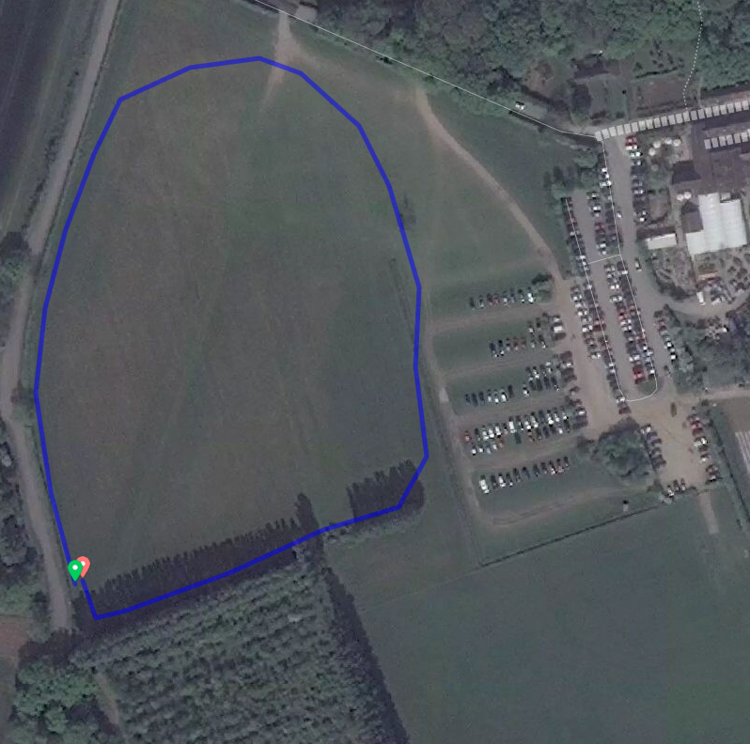

Small Lap 500m
Start

Slide 2
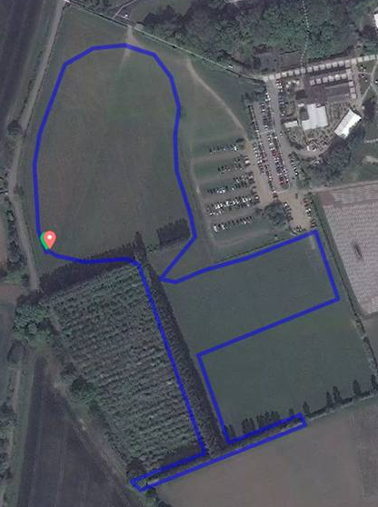
Finish straight
Medium Lap 1500m
Also showing finish Straight
Start

Slide 3
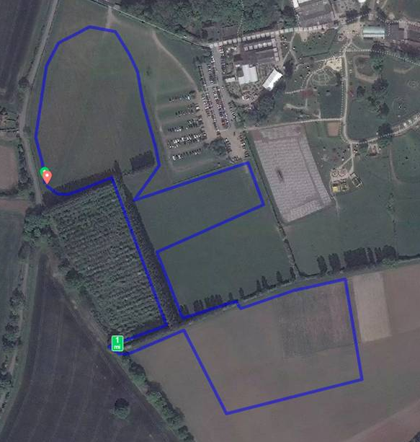
Finish straight
Large Lap 2000m
Also showing finish Straight

