Slide 1
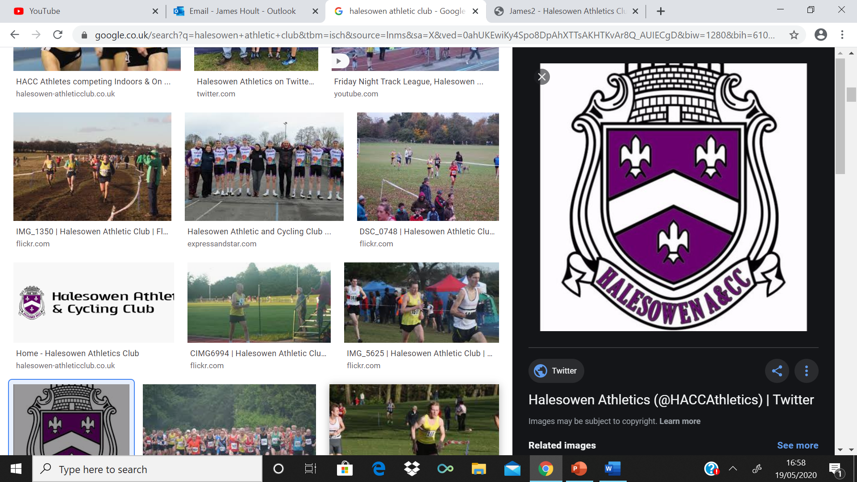
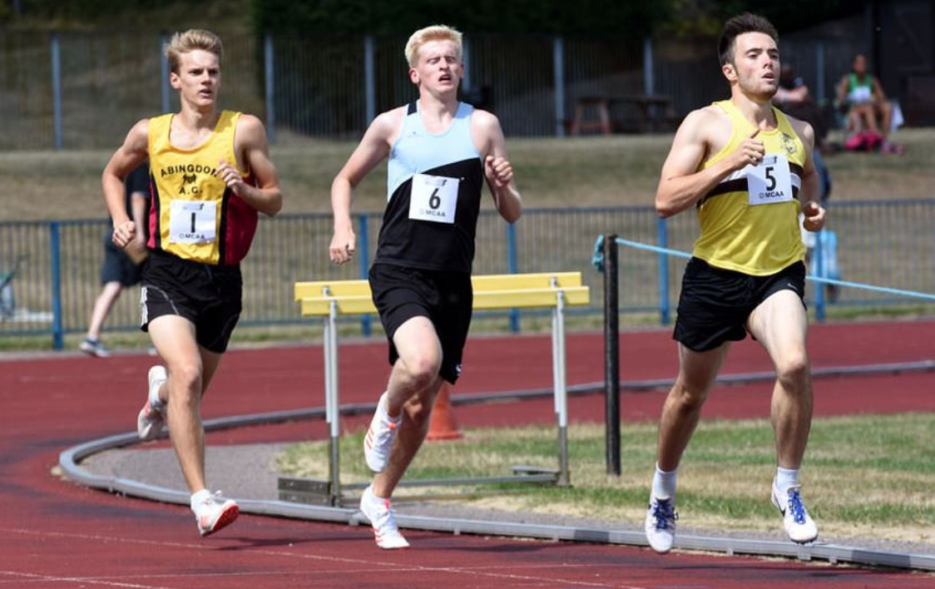
HAACC
HOULTINATOR
QUIZ
By JAMES HOULT

Slide 2

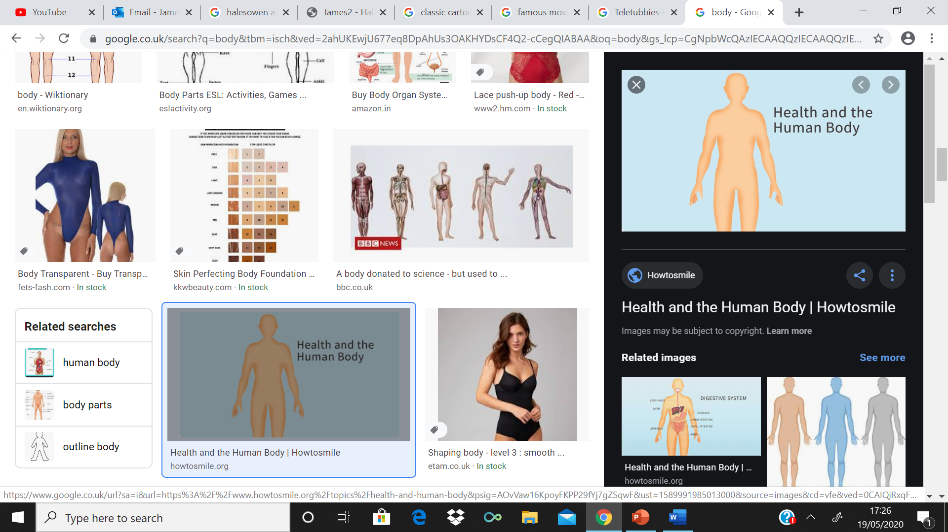
ROUND 1: GUESS WHO?
How to Play?
Guess who are the CHARACTERS IN THE PICTURE??
3 POINTS
1 Point = Head
1 Point = Body
1 Point = Legs
CLUE/HINT: They feature characters across Children’s + Adult’s TV/Movies
PLEASE DON’T SHOUT OUT THE ANSWERS!!
If you have any QUESTIONS PLEASE ASK YOUR HOST

Slide 3
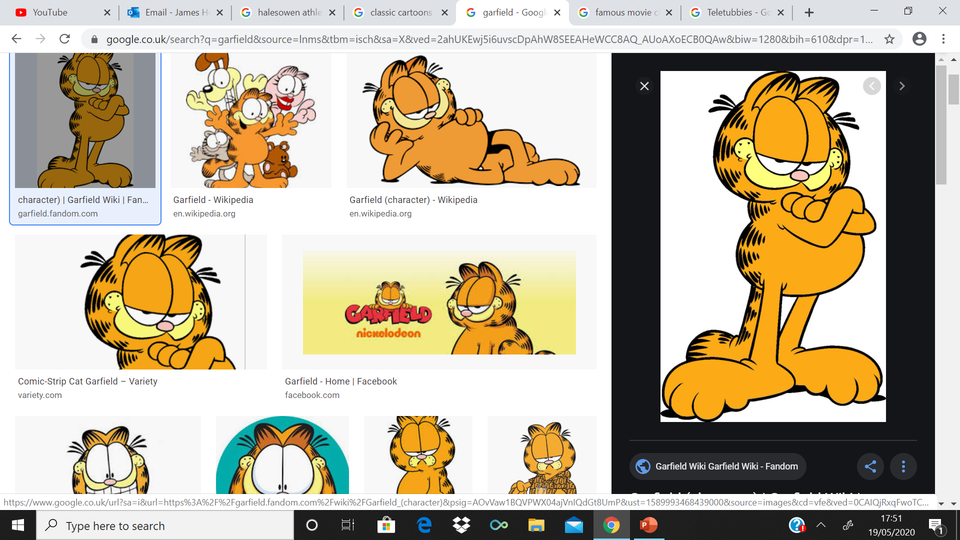
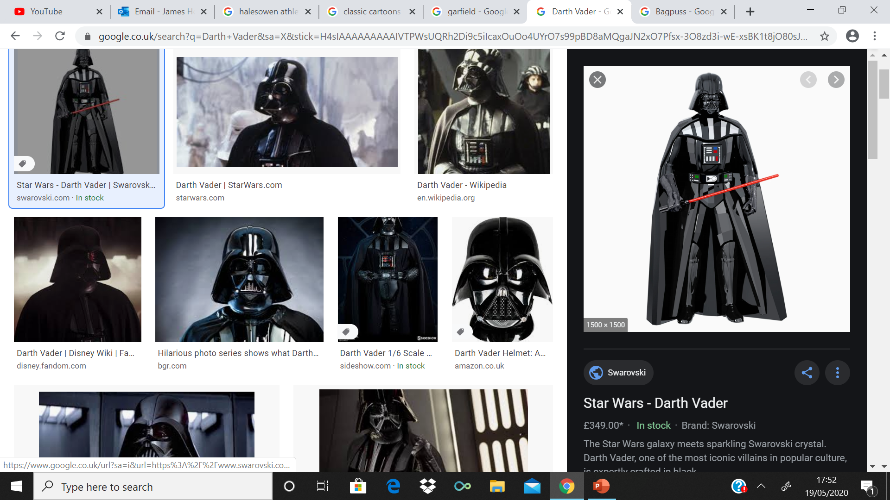
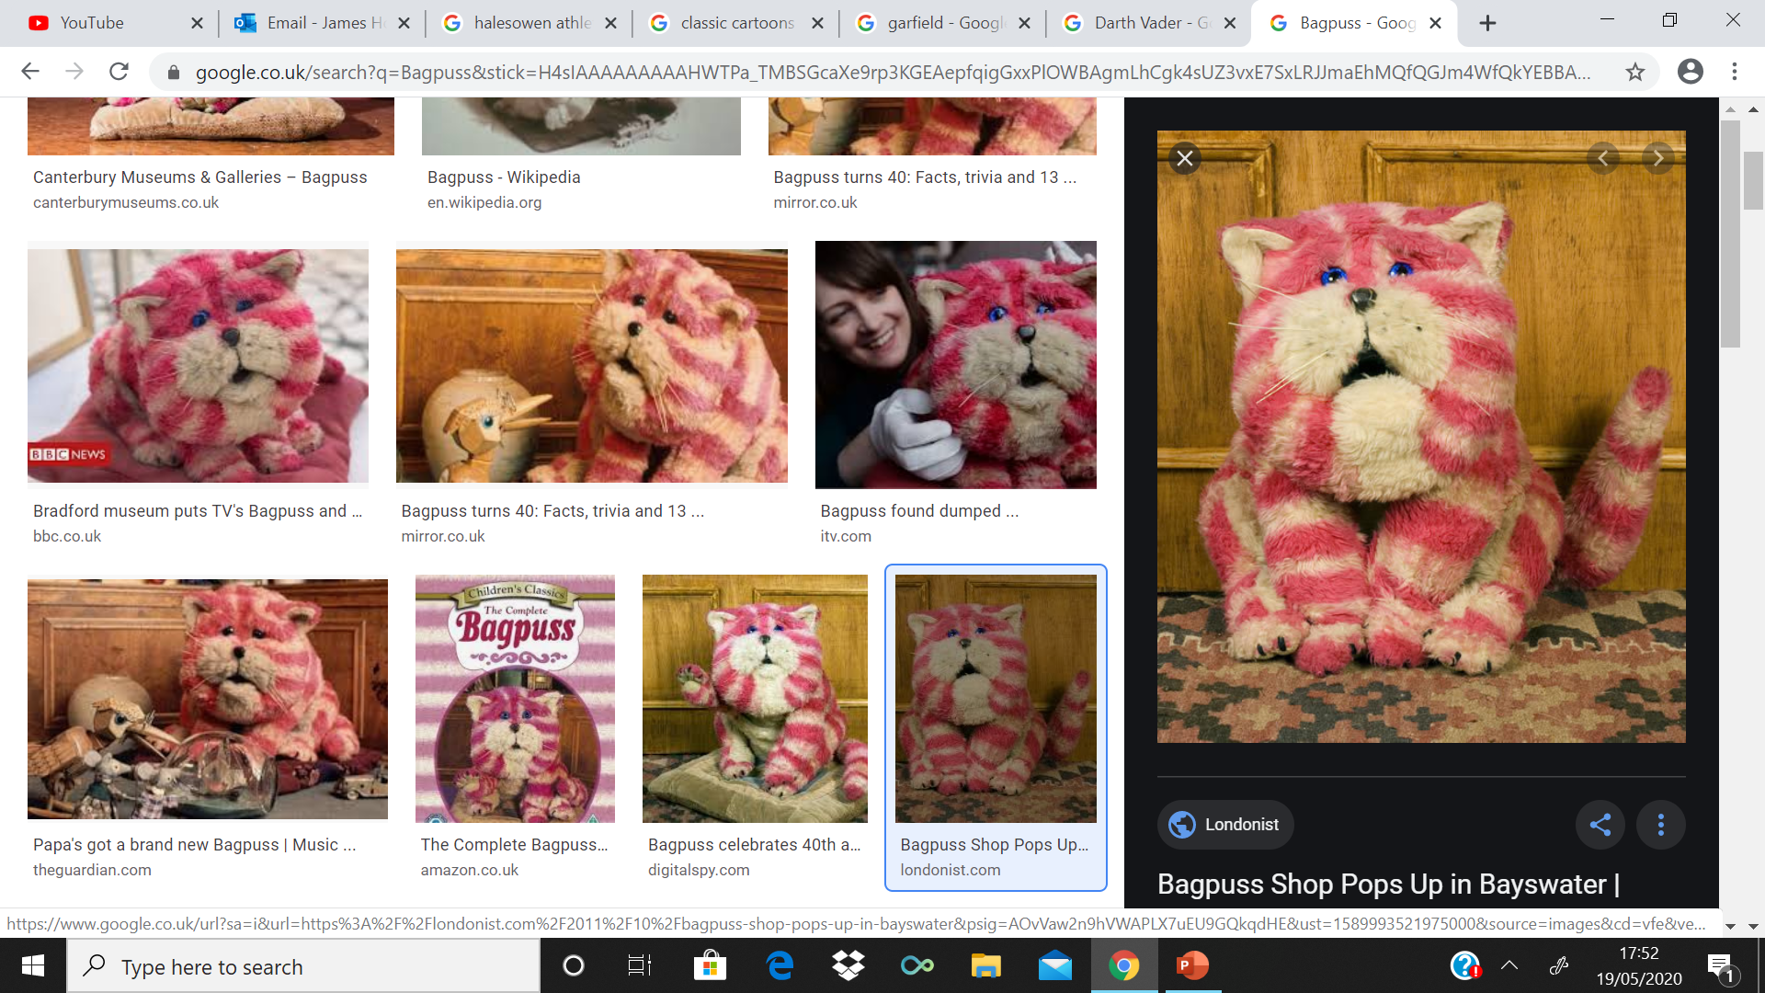
GUESS WHO??

Slide 4
ANSWERS
Head = Garfield
Body = Darth Vader or Star Wars
Legs = Bagpuss

Slide 5
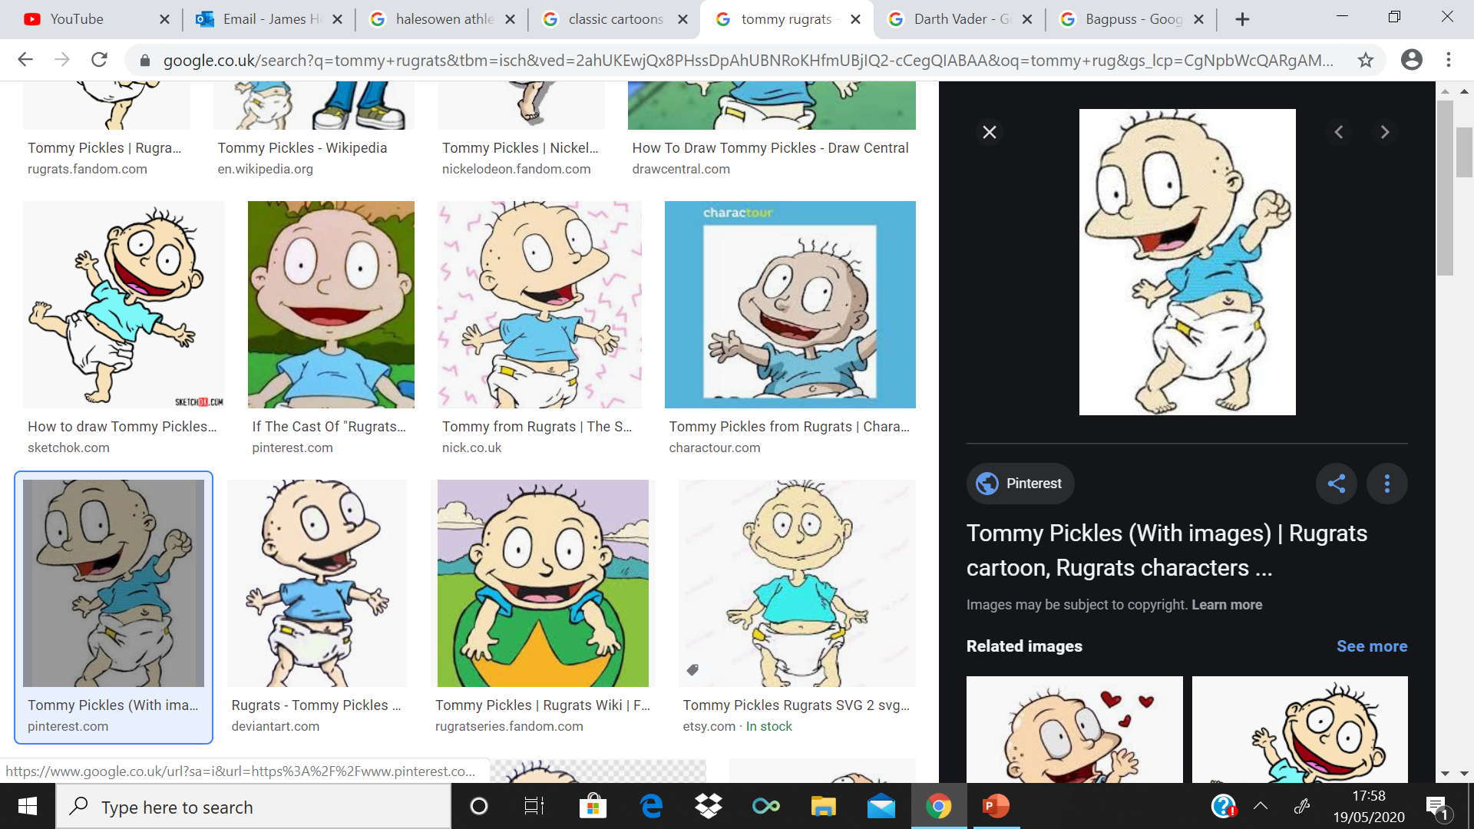
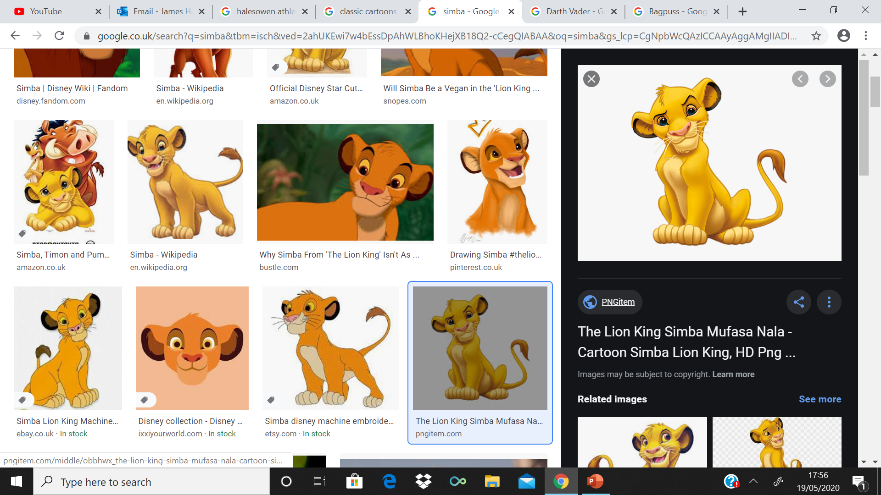
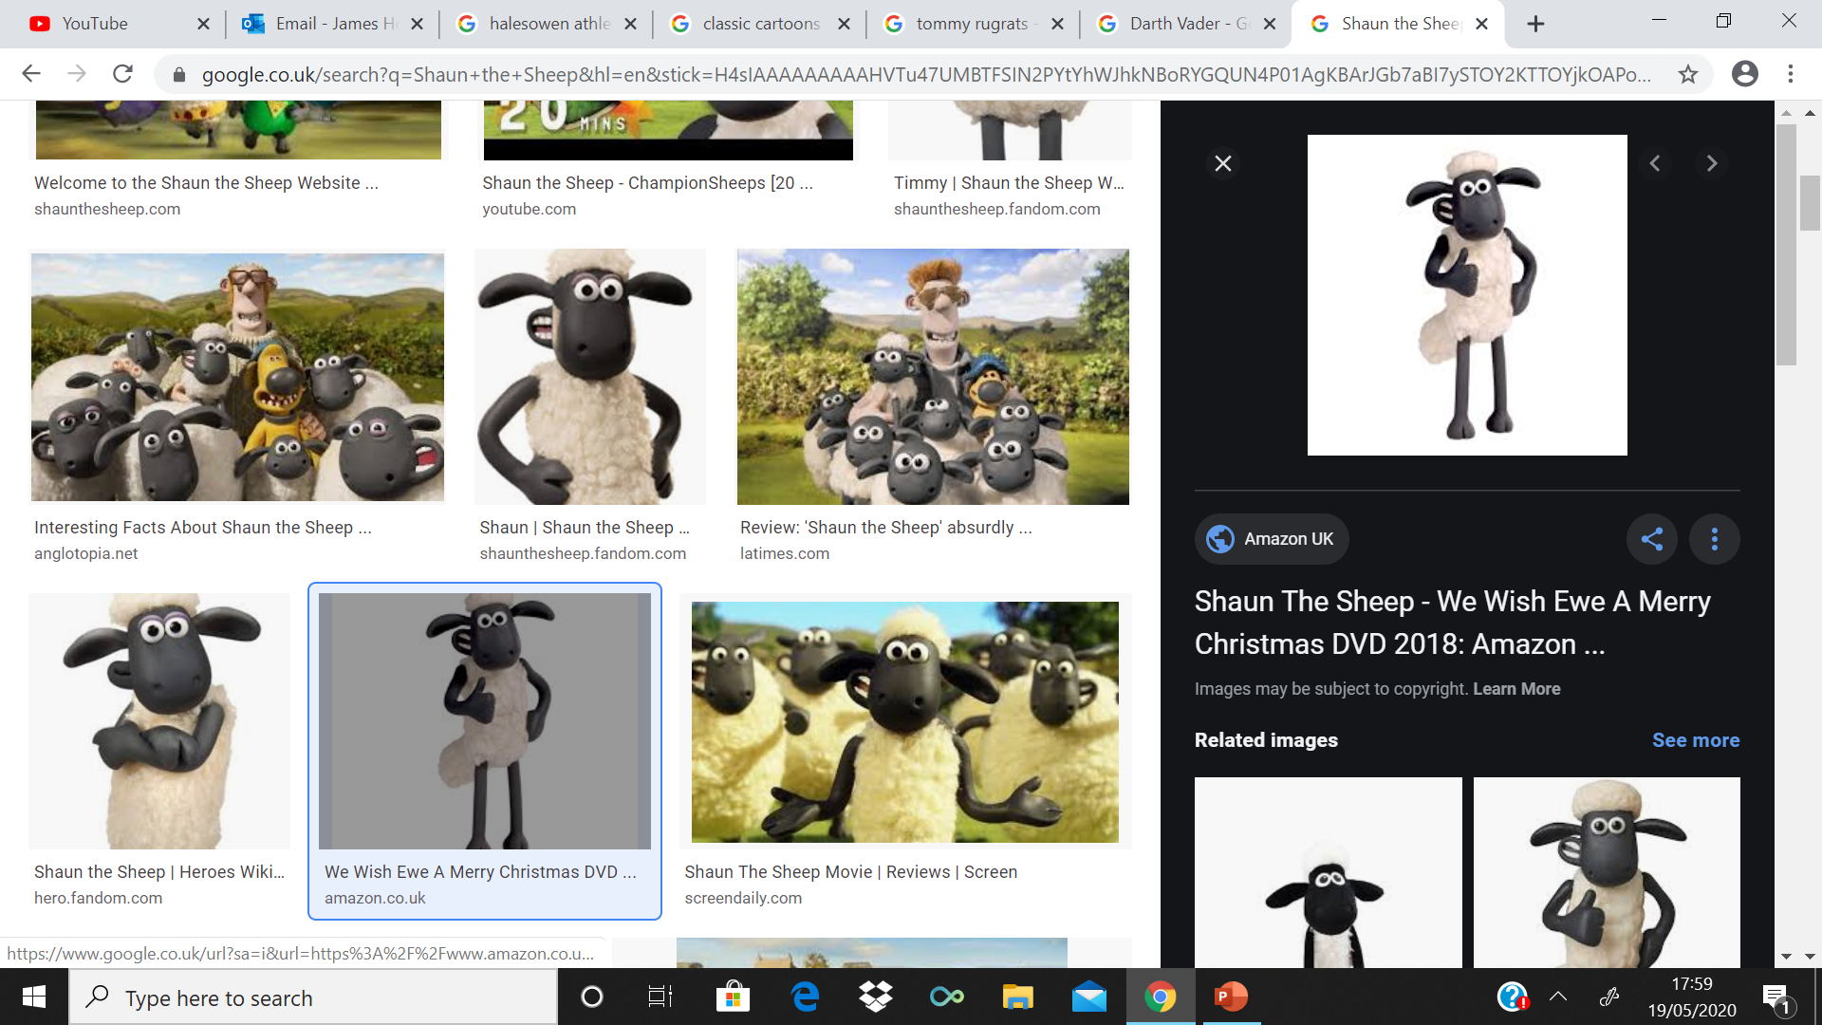
GUESS WHO??

Slide 6
ANSWERS
Head = Tommy or Rugrats
Body = Simba or The Lion King
Legs = Shaun the Sheep

Slide 7
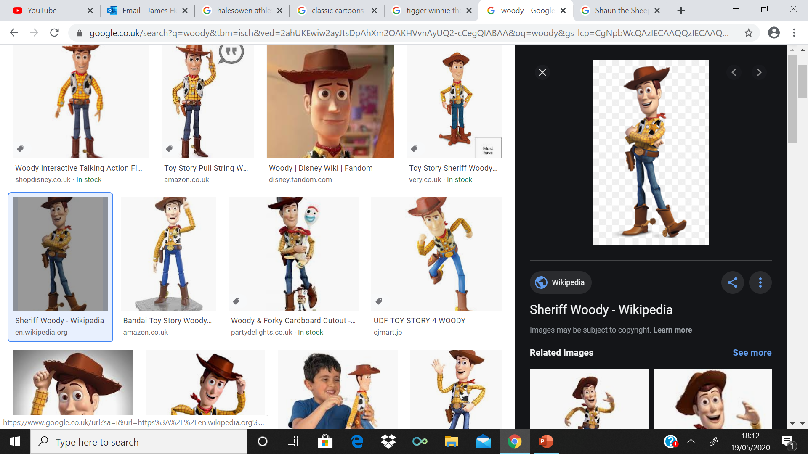
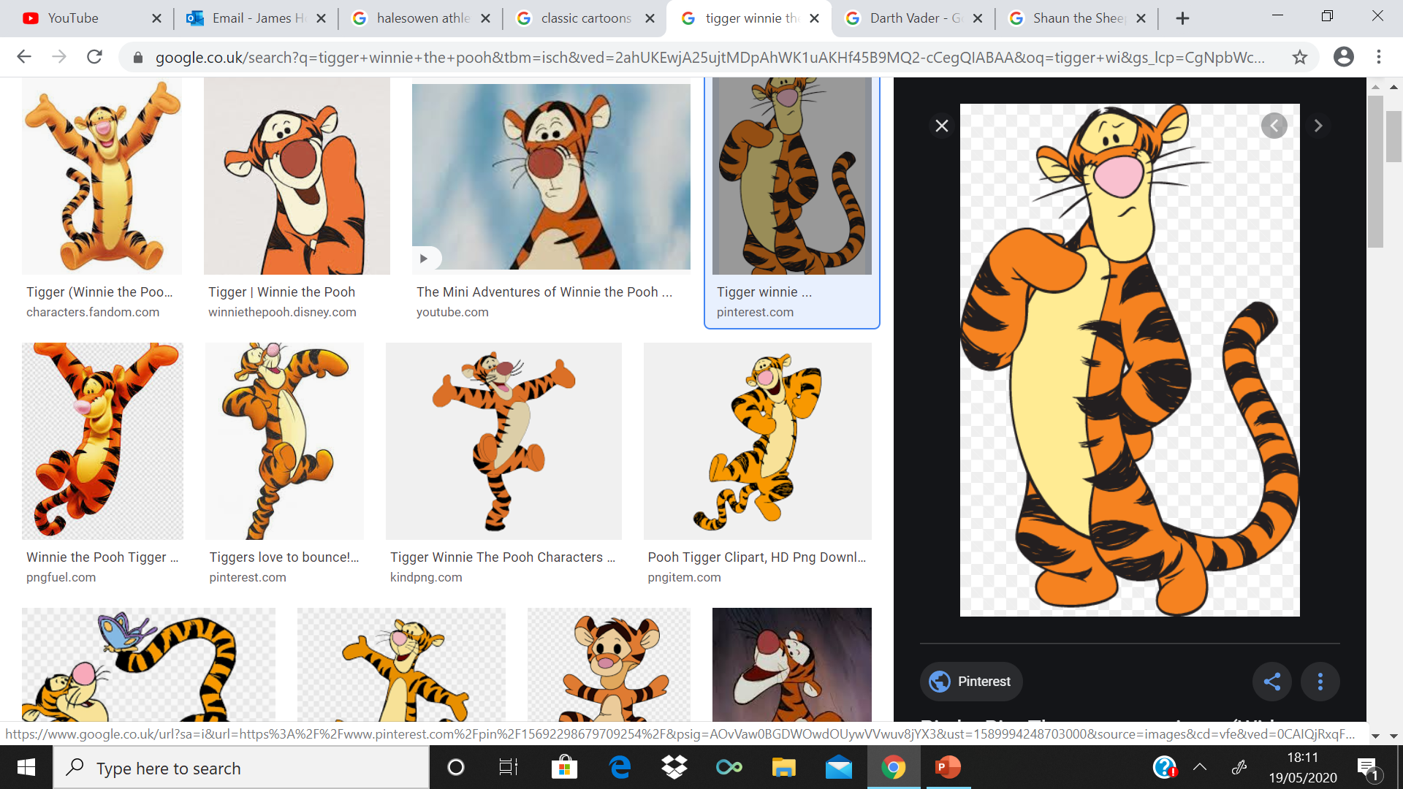
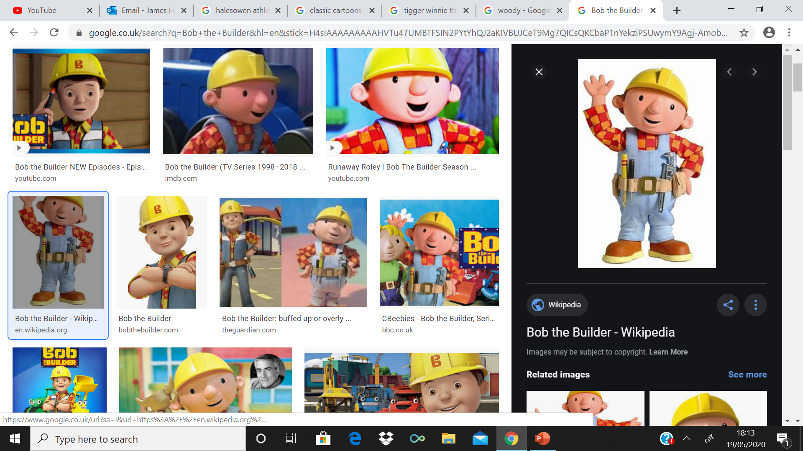
GUESS WHO??

Slide 8
ANSWERS
Head = Woody or Toy Story
Body = Tigger
Legs = Bob The Builder

Slide 9
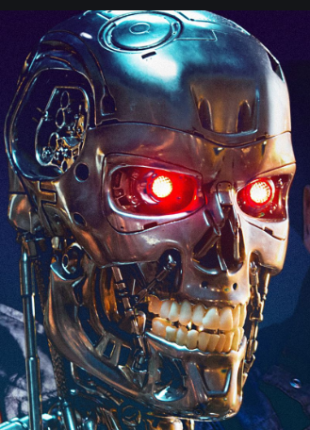
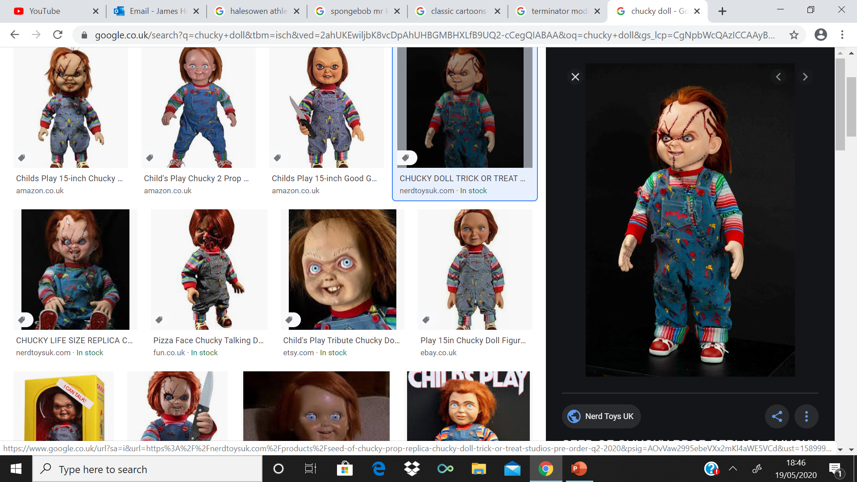
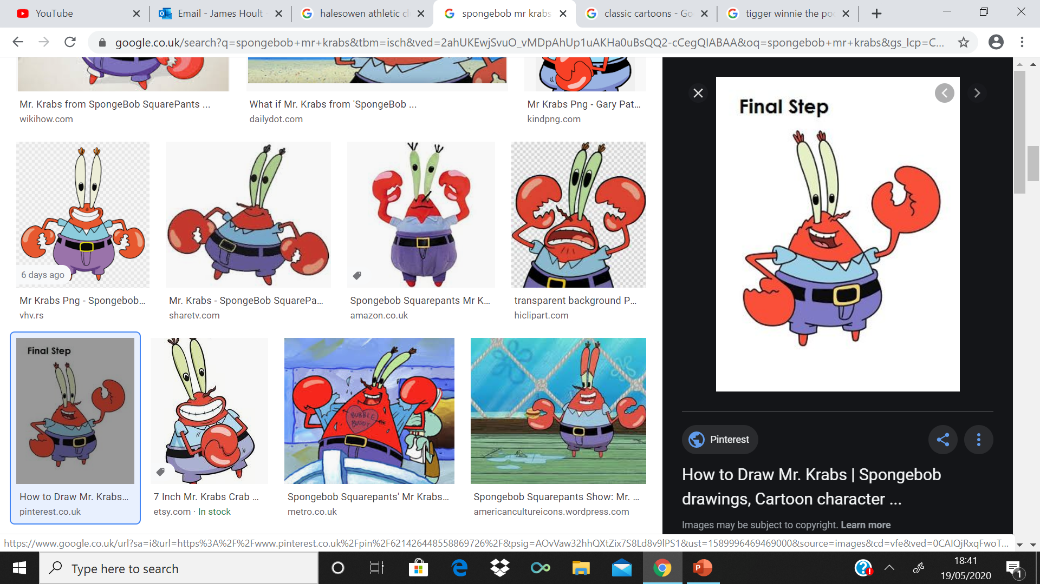
GUESS WHO??

Slide 10
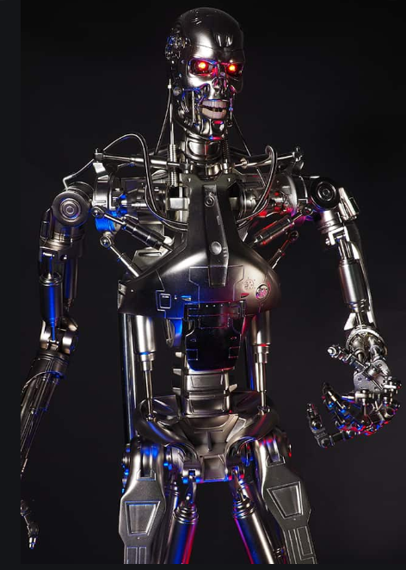
ANSWERS
Head = Terminator
Body = Chucky or Child’s Play
Legs = Mr Krabs

Slide 11
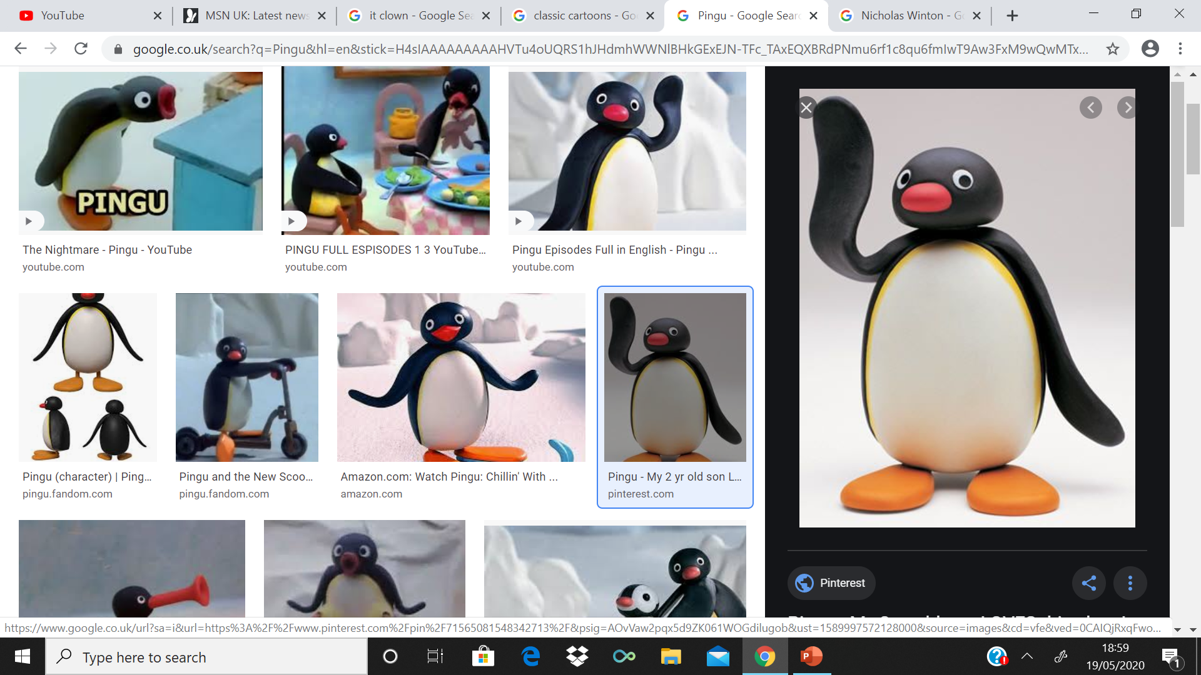
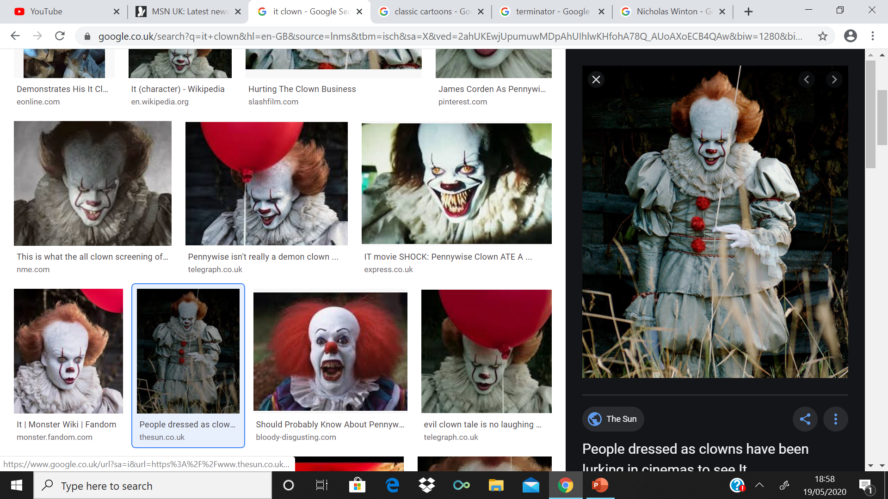
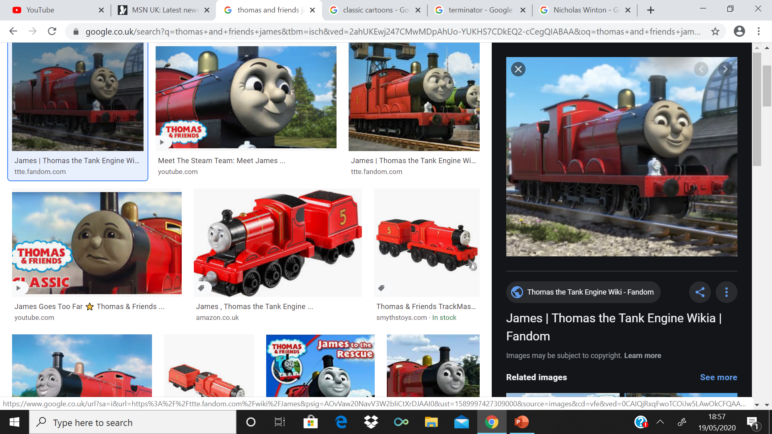
GUESS WHO??

Slide 12
ANSWERS
Head = Pingu
Body = Pennywise the Dancing Clown or IT
Legs = James or Thomas and Friends

Slide 13
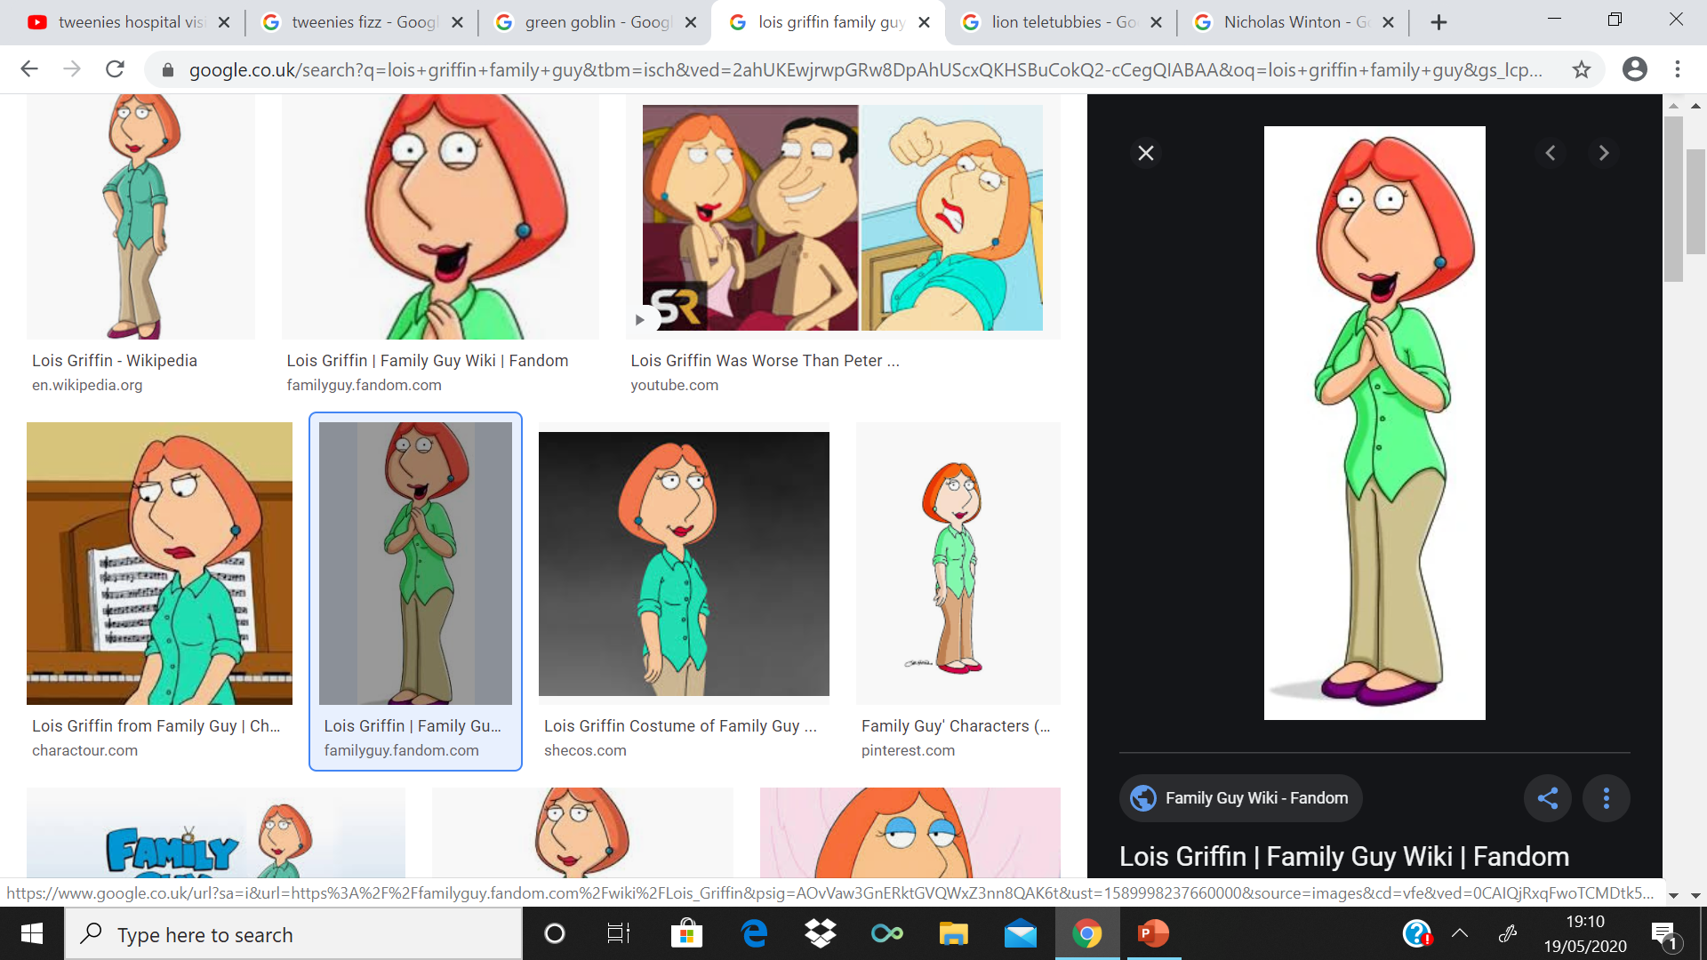
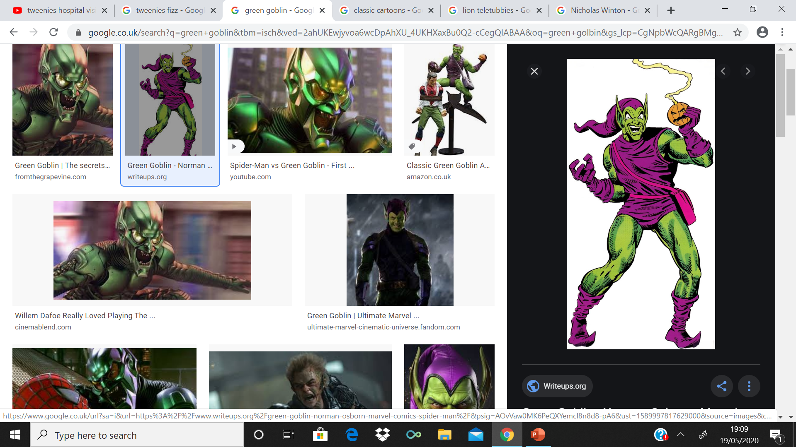
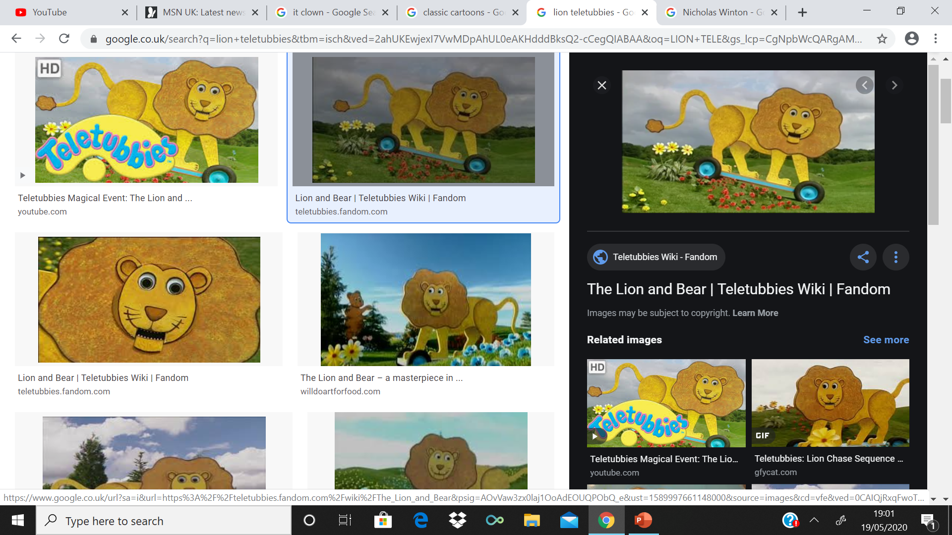
GUESS WHO??

Slide 14
ANSWERS
Head = Lois Griffin or Family Guy
Body = Green Goblin
Legs = The Lion or Teletubbies

Slide 15
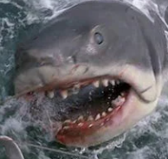
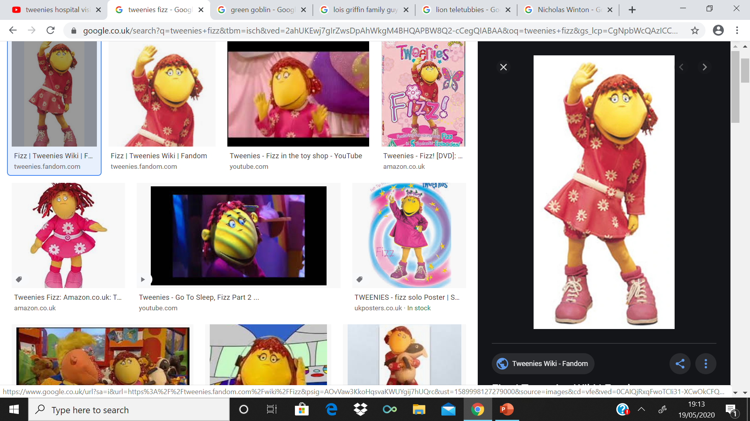
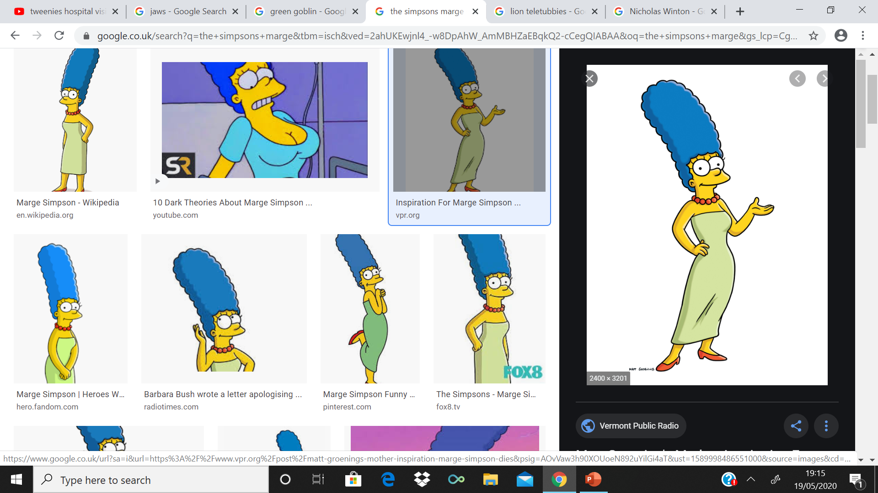
GUESS WHO??

Slide 16
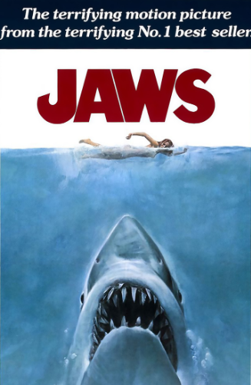
ANSWERS
Head = Jaws
Body = Fizz or Tweenies
Legs = Marge Simpson or The Simpsons

Slide 17
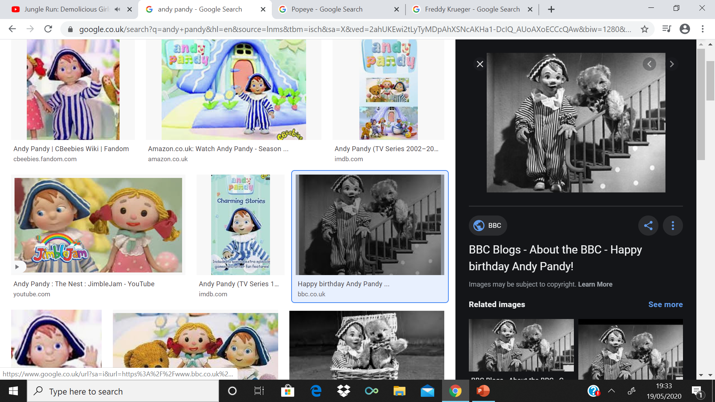
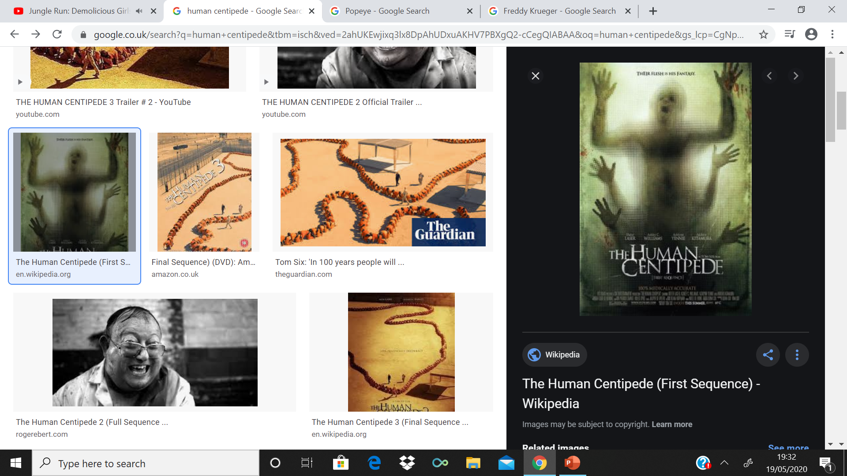
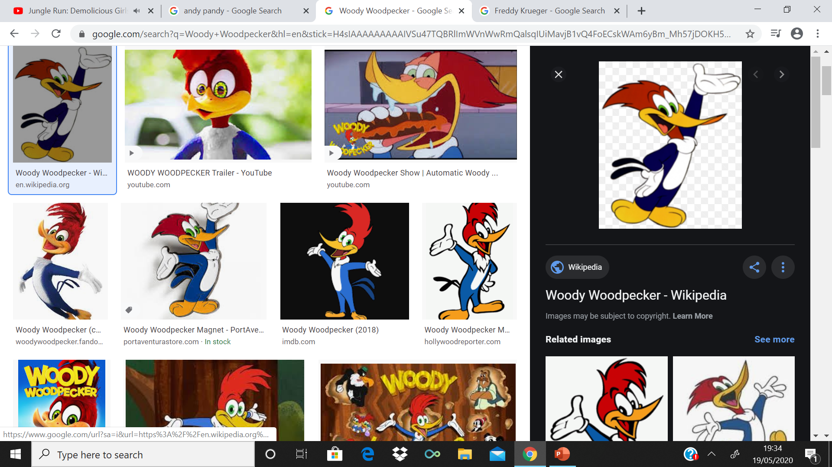
GUESS WHO??

Slide 18
ANSWERS
Head = Andy Pandy
Body = The Human Centipede
Legs = Woody Woodpecker

Slide 19
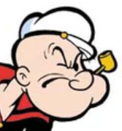
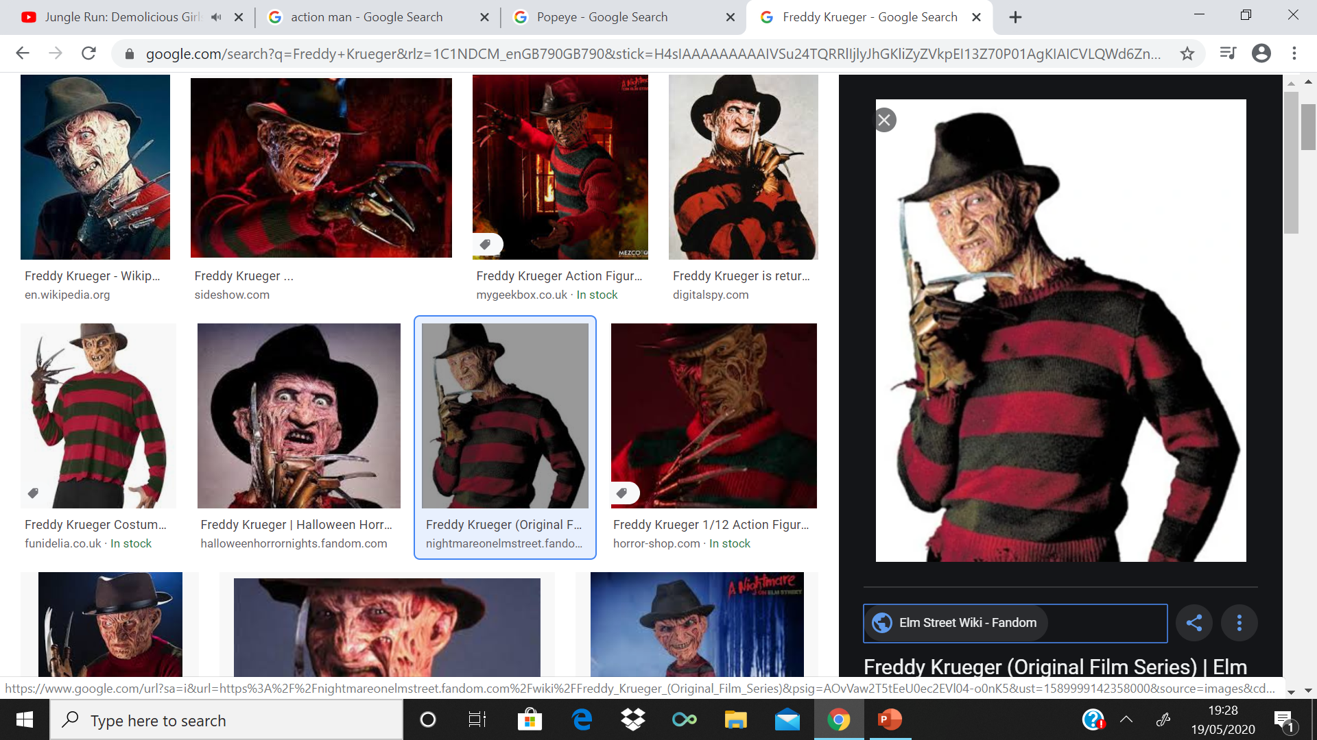
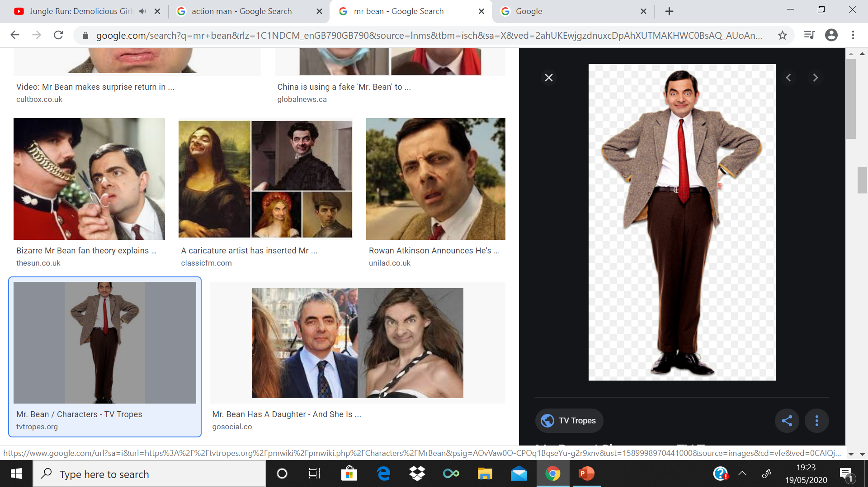
GUESS WHO??

Slide 20
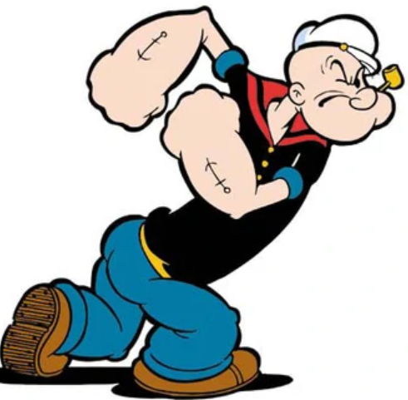
ANSWERS
Head = Popeye
Body = Freddy Krueger or A Nightmare on Elm Street
Legs = Mr Bean

Slide 21
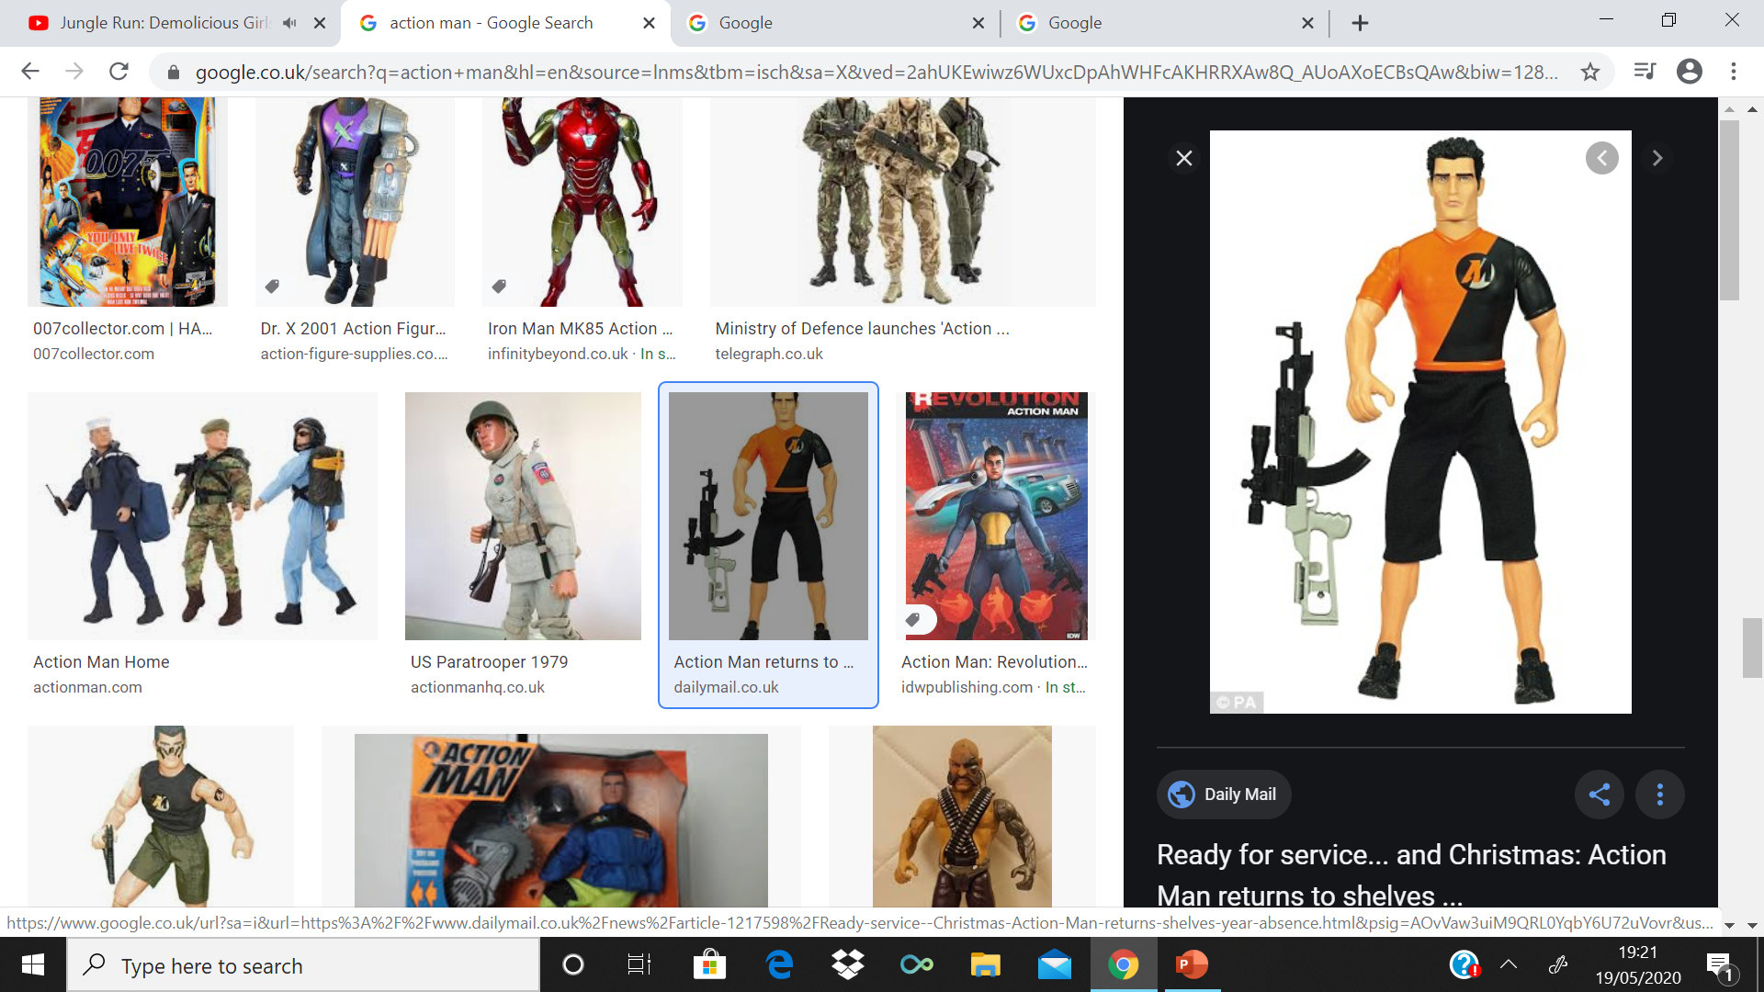
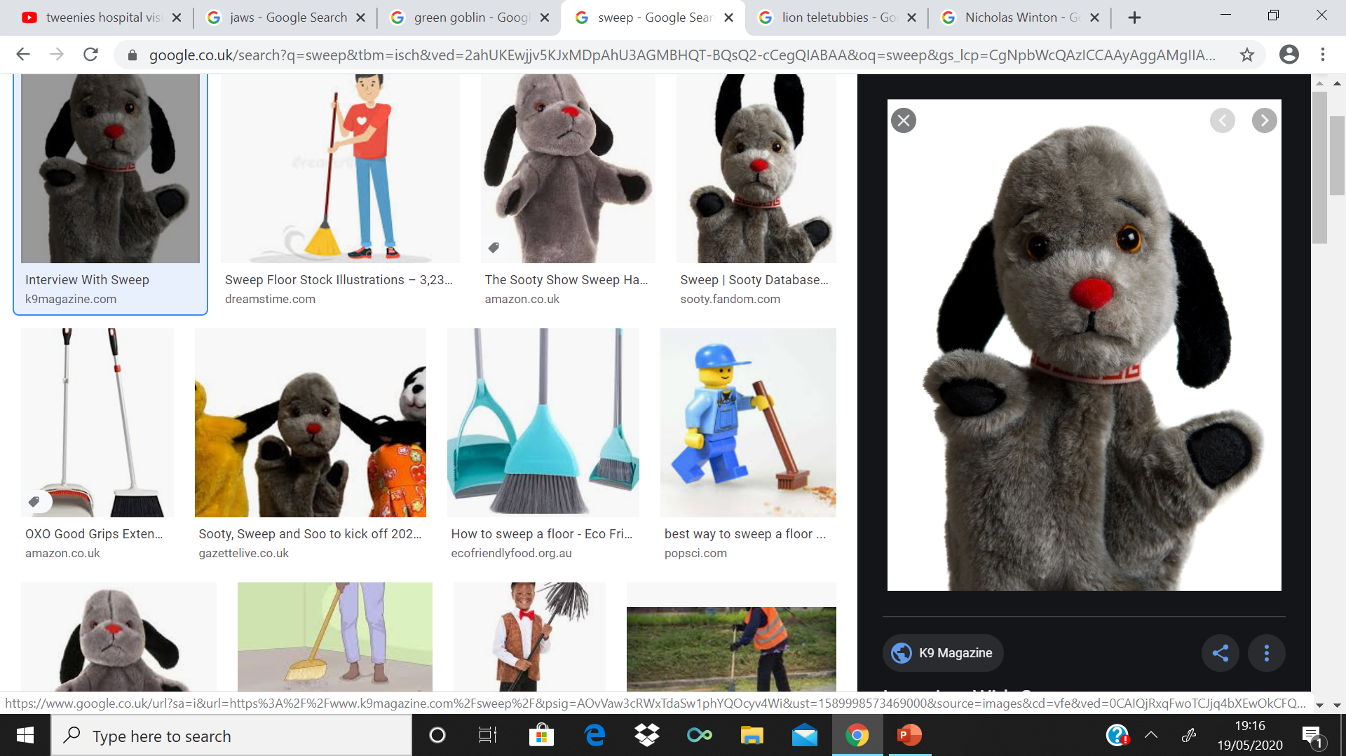
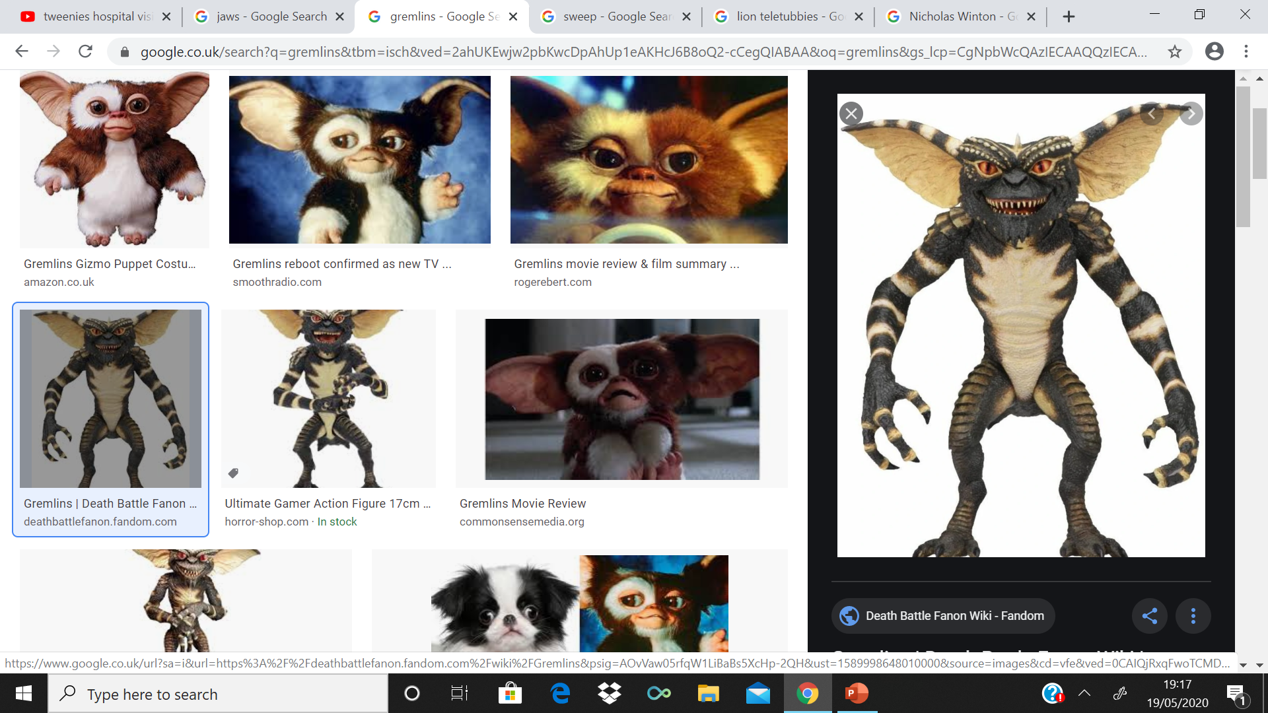
GUESS WHO??

Slide 22
Answers
Head = Action Man
Body = Sweep or The Sooty Show
Legs = Gremlin

Slide 23
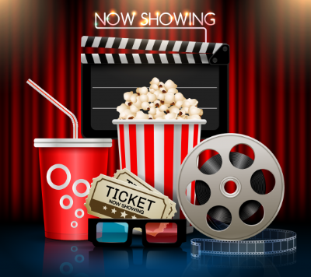
ROUND 2 NIGHT AT THE MOVIES
How to Play?
WHAT MOVIE ARE WE WATCHING TONIGHT??
2 Points
1 Point = Naming the MOVIE
1 Point = Naming THE DIRECTOR OF THE MOVIE??
CLUE/HINT: A Movie Genre and Choose of A,B + C Answers will be available TO HELP
PLEASE DON’T SHOUT OUT THE ANSWERS!!
If you have any QUESTIONS PLEASE ASK YOUR HOST

Slide 24
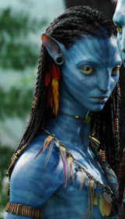
What is this MOVIE?
- CLUE: Movie Genre: Science Fiction
Who Directed this MOVIE?
A) George Lucas
B) James Cameron
C) Steven Spielberg

Slide 25
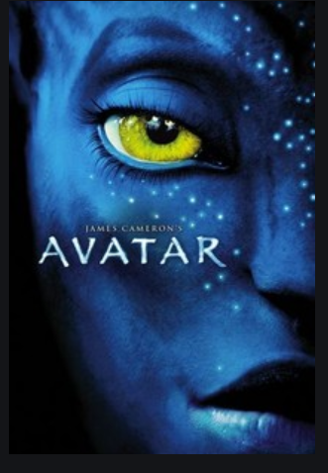
ANSWER
MOVIE: Avatar
Who Directed this MOVIE?
A) George Lucas
B) James Cameron (Correct Answer)
C) Steven Spielberg

Slide 26
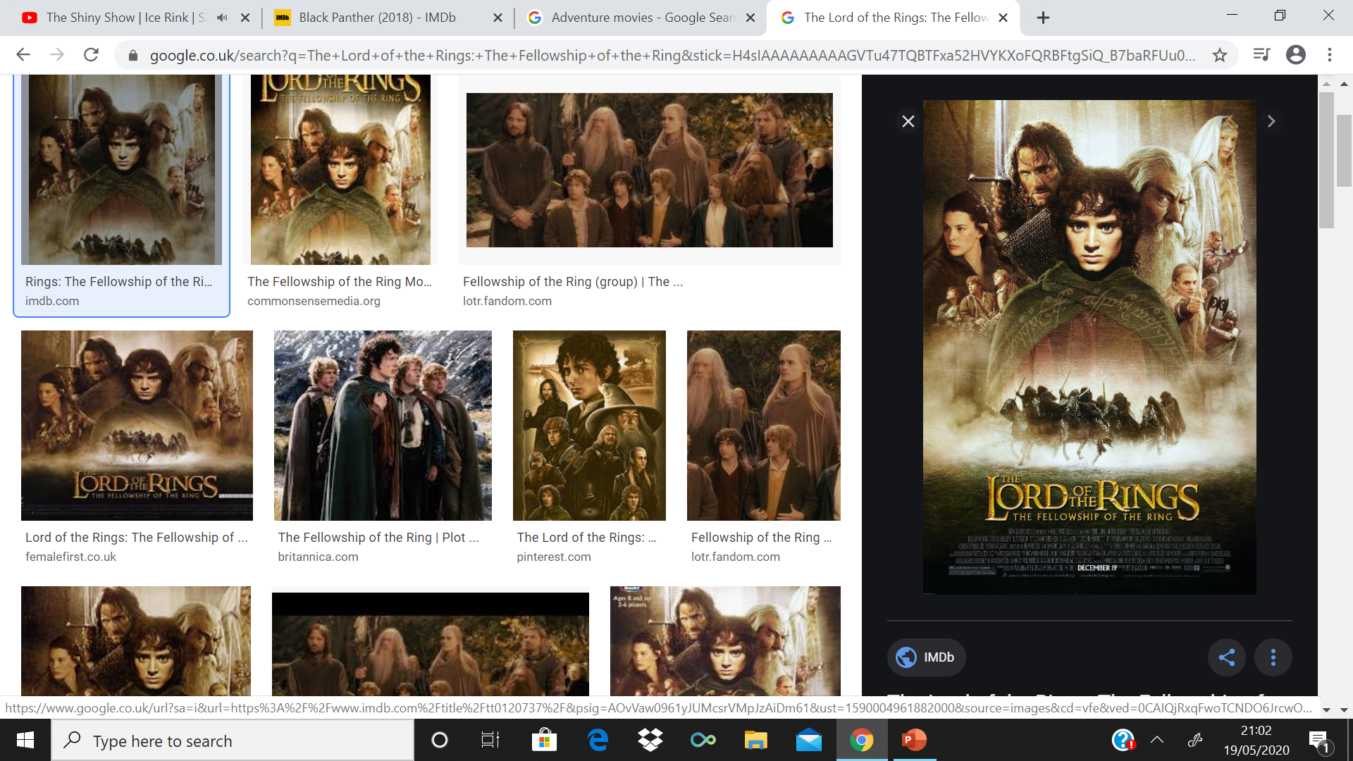
What is this MOVIE?
CLUE: Movie Genre: Adventure
Who Directed this MOVIE?
A) Peter Jackson
B) Christopher Nolan
C) Robert Zemeckis

Slide 27
ANSWER
MOVIE: The Lord of the Rings: The Fellowship of the Ring or Lord of the Rings Trilogy
Who Directed this MOVIE?
A) Peter Jackson (Correct Answer)
B) Christopher Nolan
C) Robert Zemeckis

Slide 28
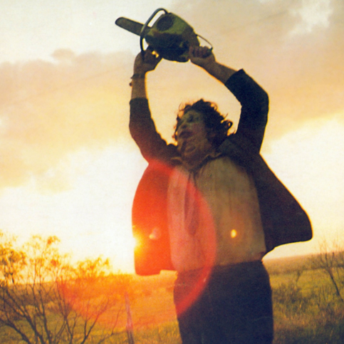
What is this MOVIE?
CLUE: Movie Genre: Horror
Who Directed this MOVIE?
A) Sam Raimi
B) John Carpenter
C) Tobe Hooper

Slide 29
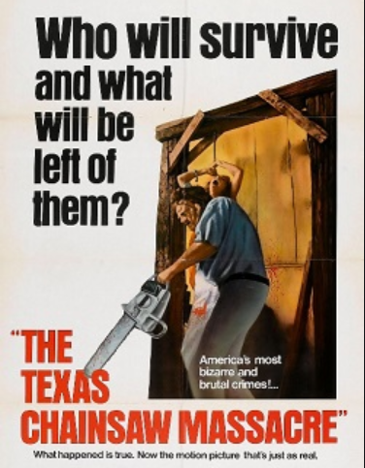
ANSWER
MOVIE: The Texas Chainsaw Massacre or Leatherface
Who Directed this MOVIE?
A) Sam Raimi
B) John Carpenter
C) Tobe Hooper (Correct Answer)

Slide 30
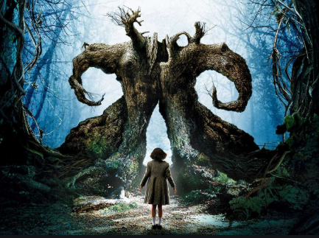
What is this MOVIE?
CLUE: Movie Genre: Fantasy
Who Directed this MOVIE?
A) Tim Burton
B) Guillermo del Toro
C) Andrew Adamson

Slide 31
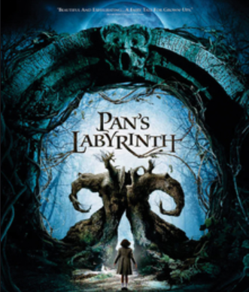
ANSWER
MOVIE: Pan’s Labyrinth
Who Directed this MOVIE?
A) Tim Burton
B) Guillermo del Toro (Correct Answer)
C) Andrew Adamson

Slide 32
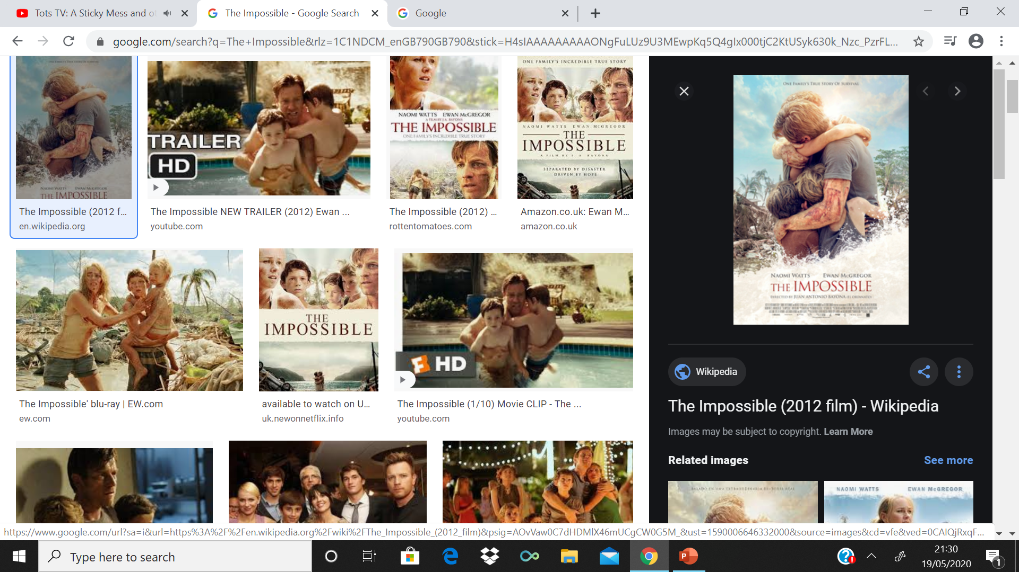
What is this MOVIE?
CLUE: Movie Genre: Disaster
Who Directed this MOVIE?
A) Roland Emmerich
B) Dean Devlin
C) J.A. Bayona

Slide 33
ANSWER
MOVIE: The Impossible
Who Directed this MOVIE?
A) Roland Emmerich
B) Dean Devlin
C) J.A. Bayona (Correct Answer)

Slide 34
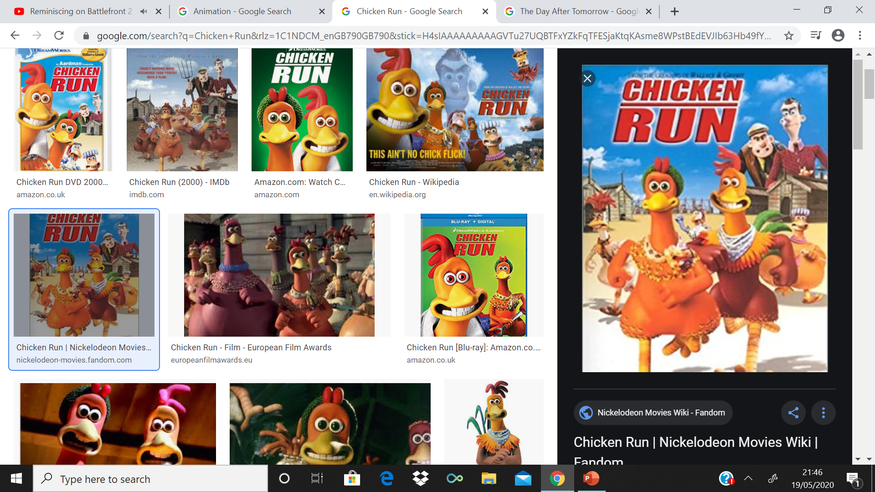
What is this MOVIE?
CLUE: Movie Genre: Animation
Who Directed this MOVIE?
A) Peter Lord and Nick Park
B) Steve Box and Nick Park
C) David Bowers and Sam Fell

Slide 35
ANSWER
MOVIE: Chicken Run
Who Directed this MOVIE?
A) Peter Lord and Nick Park (Correct Answer)
B) Steve Box and Nick Park
C) David Bowers and Sam Fell

Slide 36
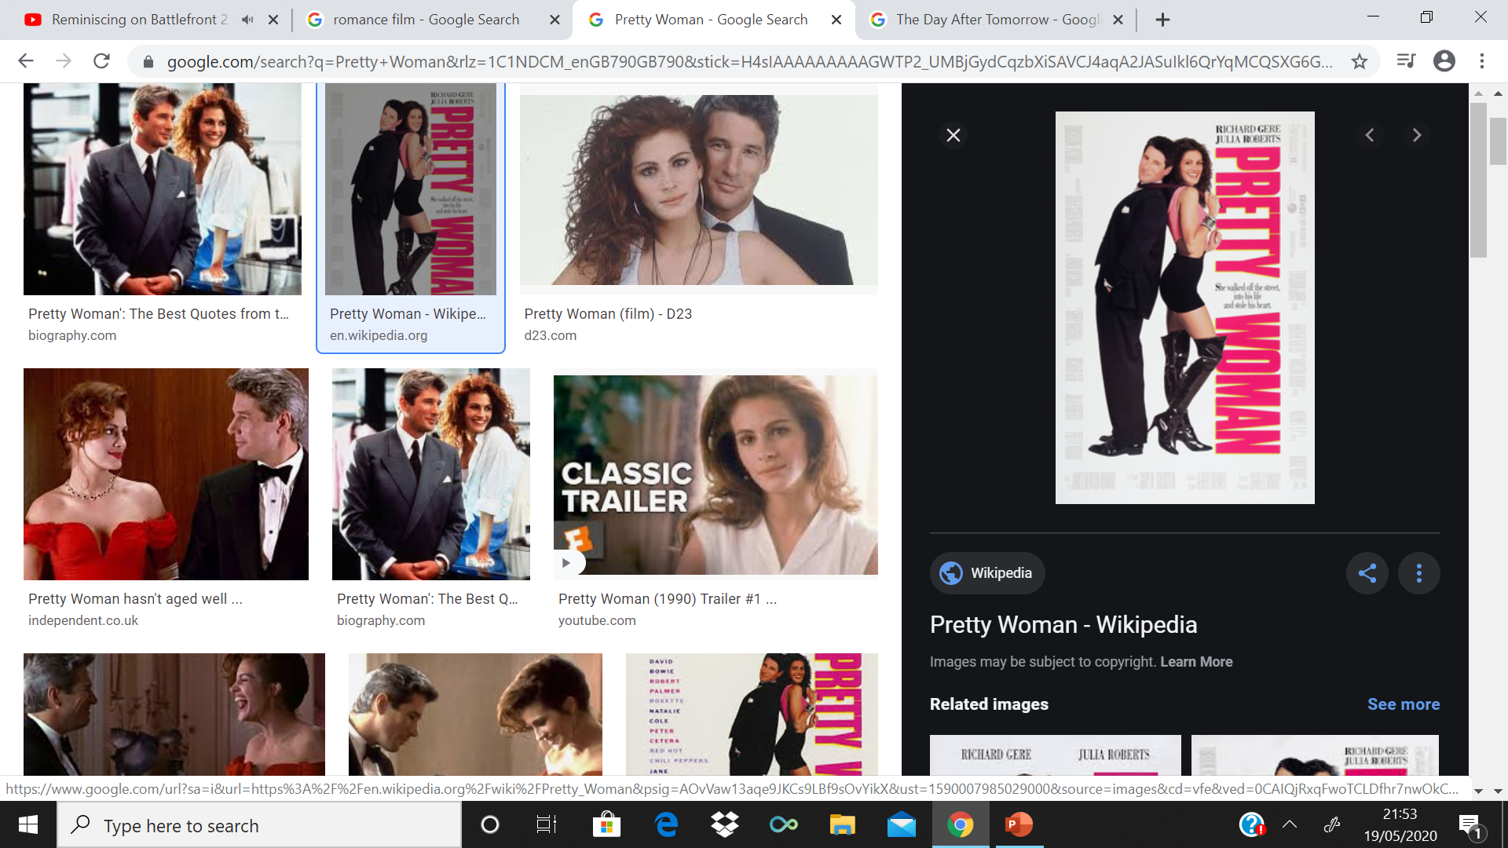
What is this MOVIE?
CLUE: Movie Genre: Romance
Who Directed this MOVIE?
A) Sharon Maguire
B) Garry Marshall
C) Emile Ardolino

Slide 37
ANSWER
MOVIE: Pretty Woman
Who Directed this MOVIE?
A) Sharon Maguire
B) Garry Marshall (Correct Answer)
C) Emile Ardolino

Slide 38
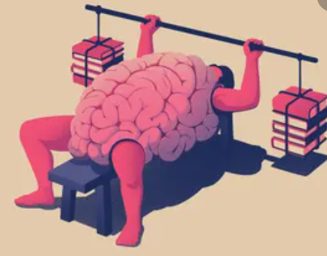
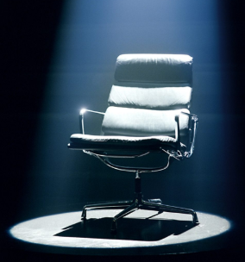
ROUND 3: MASTERMIND
How to Play?
HOW BRAINY ARE YOU?
Well Answer these QUESTIONS CORRECTLY!!
2 Points = CORRECT
0 Points = INCORRECT
CLUE/HINT: Choose A, B OR C, if you don’t know – GO WITH YOUR HONEST OPINION
PLEASE DON’T SHOUT OUT THE ANSWERS!!
If you have any QUESTIONS PLEASE ASK YOUR HOST

Slide 39
Q1
The Bichon Frise is a breed of what?
Dog
Cow
Sheep

Slide 40
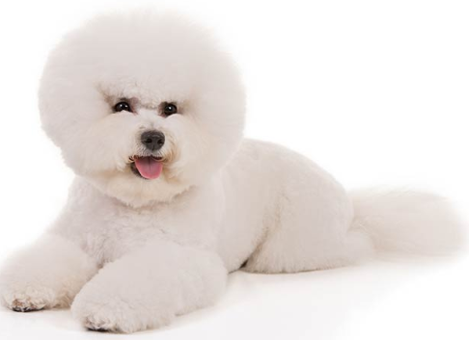
ANSWER
The Bichon Frise is a breed of what?
Dog
Cow
Sheep
Answer: a) Dog

Slide 41
Q2
'Stupid Love' was the debut single from the album 'Chromatica' from which US superstar?
a) Lady Gaga
b) Britney Spears
c) Madonna

Slide 42

ANSWER
'Stupid Love' was the debut single from the album 'Chromatica' from which US superstar?
a) Lady Gaga
b) Britney Spears
c) Madonna
Answer: a) Lady Gaga

Slide 43
Q3
The world’s first text message was sent on the 3rd of December of which year?
a) 1972
b) 1982
c) 1992

Slide 44

ANSWER
The world’s first text message was sent on the 3rd of December of which year?
a) 1972
b) 1982
c) 1992
Answer: c) 1992

Slide 45
Q4
The UK Government's Northern Ireland secretary suggested in February 2018 that a power sharing deal was still possible. Can you name her?
a) Karen Bradley
b) Justine Greening
c) Liz Truss

Slide 46

ANSWER
The UK Government's Northern Ireland secretary suggested in February 2018 that a power sharing deal was still possible. Can you name her?
a) Karen Bradley
b) Justine Greening
c) Liz Truss
Answer: a) Karen Bradley

Slide 47
Q5
How many nations competed at the first modern Olympics in 1896?
a) 8
b) 14
c) 20

Slide 48

ANSWER
How many nations competed at the first modern Olympics in 1896?
a) 8
b) 14
c) 20
Answer: b) 14

Slide 49
Q6
'Time on Our Hands' was an episode of Only Fools and Horses where Del Boy and Rodney became millionaires and was watched by a record audience for a sitcom. Was it?
a) 18.3m
b) 21.3m
c) 24.3m

Slide 50

ANSWER
'Time on Our Hands' was an episode of Only Fools and Horses where Del Boy and Rodney became millionaires and was watched by a record audience for a sitcom. Was it?
a) 18.3m
b) 21.3m
c) 24.3m
Answer: c) 24.3m

Slide 51
Q7
Which of the three main rock types signifies the cooling and solidification of magma or lava?
a) Sedimentary
b) Metamorphic
c) Igneous

Slide 52

ANSWER
Which of the three main rock types signifies the cooling and solidification of magma or lava?
a) Sedimentary
b) Metamorphic
c) Igneous
Answer: c) Igneous

Slide 53
Q8
Which American actor plays Scott Lang in 'Ant-Man and the Wasp’?
a) Paul Rudd
b) Michael Douglas
c) Bradley Cooper

Slide 54

ANSWER
Which American actor plays Scott Lang in 'Ant-Man and the Wasp'?
a) Paul Rudd
b) Michael Douglas
c) Bradley Cooper
Answer: a) Paul Rudd

Slide 55







THANKS FOR PLAYING
HOPE YOU ALL ENJOYED IT
REMEMBER
BUT MOST IMPORTANTLY UP OWEN BECAUSE WE’LL MEET AGAIN

